Slide 1
PRESENTATION

Slide 2
AGENDA
Functions & Modules
Data manipulation in python

Slide 3
FUCTIONS & MODULES
MODULES
A module is simply a Python file with a .py extension that can be imported inside another Python program.
The name of the Python file becomes the module name.
The Module Contains
definitions and implementation of classes
variables
functions that can be used inside another program.
FUNCTIONS
A function is a block of code which only runs when it is called. You can pass data, known as parameters, into a function.
Functions are two types:-
User-defined Functions :
Built-in Functions

Slide 4
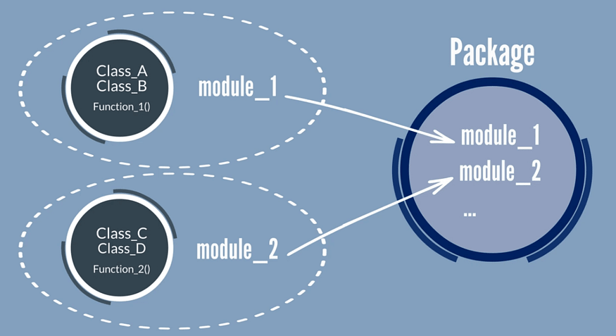

Slide 5
Data manipulation in python
Data manipulation in Python involves various operations that allow you to modify, clean, transform, and analyze data. There are several libraries in Python that are commonly used for data manipulation, with the most popular being:
NUMPY:-This library provides support for working with arrays and matrices, along with a large collection of high-level mathematical functions to operate on these arrays.
PANDAS:-Pandas is built on top of NumPy and provides data structures like DataFrames and Series, which are powerful for data manipulation and analysis. It's especially useful for working with structured data.
MATPLOTLIB AND SEABORN: These are used for data visualization, which is an important aspect of data manipulation. They allow you to create various types of plots and charts to better understand your data.
SCIPY: This library builds on NumPy and provides additional functionality for scientific computing, including optimization, integration, linear algebra, and more.

Slide 6
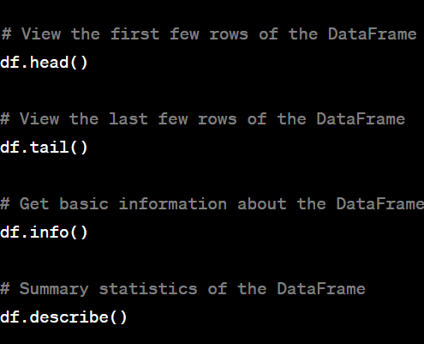
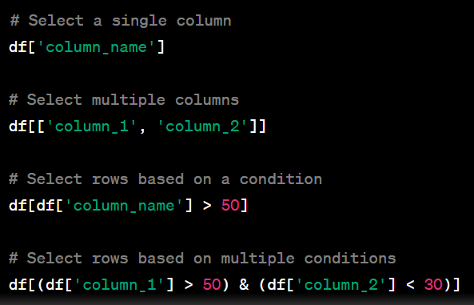
Viewing data Selecting data

Slide 7
THANK YOU

